Slide 1
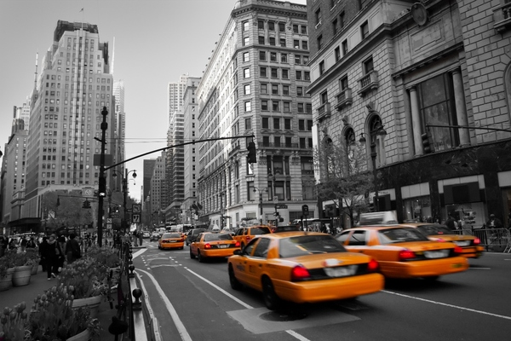
Analysis and predictions of the
New York taxi market
May-June 2020
Simona Hristescu

Slide 2
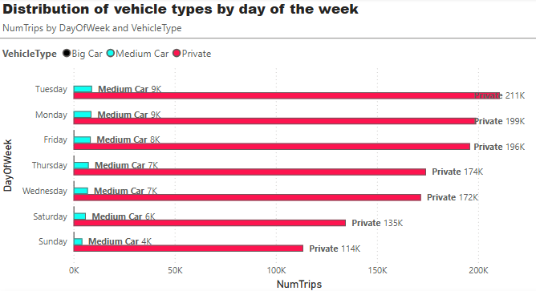
💡 What is the distribution of vehicle types by day of the week?
Private Vehicles are the dominant category. This type of vehicle is by far the most used on all days of the week.
Medium Cars have a low usage. The number of trips with “Medium Cars” is significantly lower than private ones.
Tuesday and Monday have the most trips (9K each), followed by Friday (8K). Sunday is the weakest day for this category, with only 4K trips.
Big Car – very few in the graph.
Tuesday and Monday are the first working days, so a much higher number of trips are made. Considering that Sunday is on the weekend, the number of trips is the lowest, people do not work, choose to stay home or do other recreational activities.

Slide 3
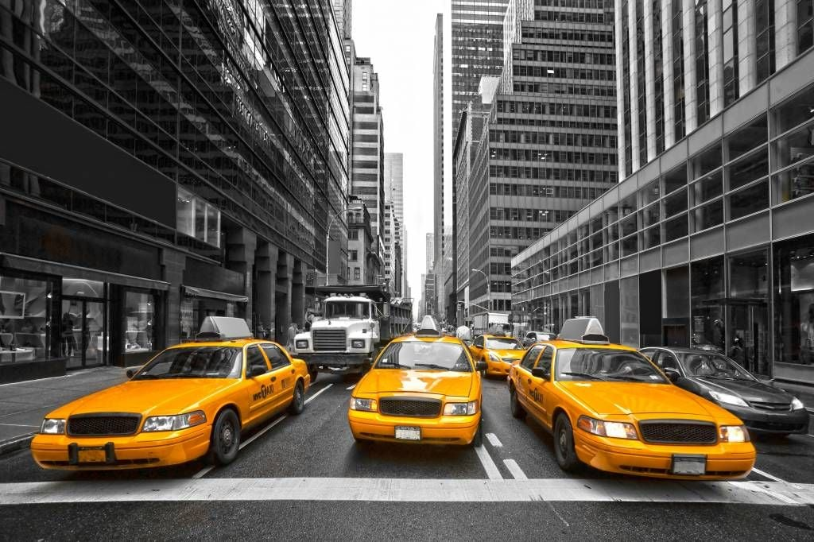
📆 Consumer behaviors by day:
Workdays (Monday-Friday):
have a high volume of trips, especially with private vehicles (for commuting).
Weekends (Saturday and Sunday):
Considerably low volume (pandemic restrictions or reduced activities), customers no longer have to go to work and have recreational activities.
💡 Conclusions and interpretations:
✅ Private vehicles completely dominated transportation during the analyzed period.
✅ Possibly in the context of the COVID-19 pandemic, public transportation was avoided.
✅ In addition, large vehicles were avoided, and customers preferred small vehicles, without sharing rides with anyone else.

Slide 4
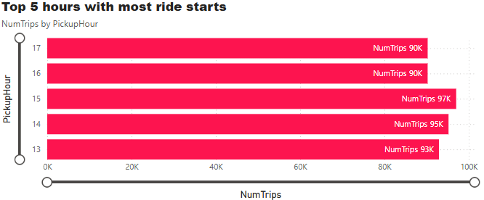
💡 What are the top 5 hours with the most trips started?
The graph highlights the time slots with the most trips started
🔍 Relevant observations:
Peak period: afternoon (1:00 PM–5:00 PM): 3:00 PM is the peak hour, with the most trips (97K).
Increasing trend followed by a slight decrease: the number of trips increases from 1:00 PM to 3:00 PM, then starts to decrease slightly at 4:00 PM and 5:00 PM (transition from lunchtime activities to the end of the work schedule).
💼 Possible interpretations:
Work or school-related transportation: these hours correspond to the times when people finish their part-time work, classes or have other personal trips.

Slide 5
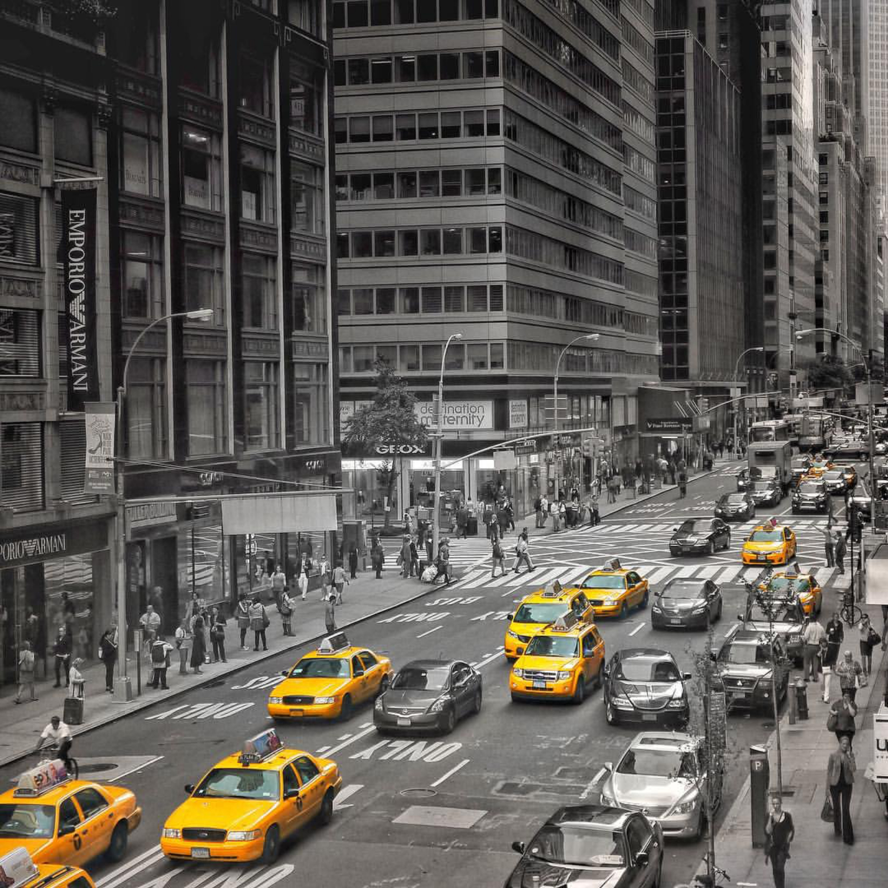
Avoidance of busy morning rush hours: May reflect pandemic-specific behavior, where work schedules were more flexible or morning activities were reduced.
Deliveries or on-demand services: The increase from 1:00 PM onwards could also be influenced by the use of ride-hailing services for orders or deliveries.
✅ Conclusion:
The graph confirms that the most intense taxi activity in New York, during the analyzed period, occurs between 13:00–17:00, with an absolute peak at 15:00.
This data is useful for:
Optimizing vehicle fleet availability;
Dynamic pricing strategies (surge pricing);
Route and operations planning for transportation companies

Slide 6
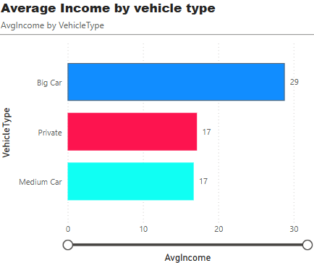
💡 What is the average income earned by vehicle type?
The chart compares the average income earned per trip by vehicle type:
🚙 Big Car: 🥇 29 USD per trip
🚗 Private Car: 17 USD per trip
🚘 Medium Car: 17 USD per trip
🔍 Detailed Analysis
🔵 Big Car – Significantly higher average earnings
The difference is clear and significant: large vehicles bring in, on average, ~70% more than the other two categories.
This may indicate:
Longer trips or with more passengers.
Higher fares (e.g. for increased comfort or groups).
Corporate or premium use.
🔴 Private & Medium Cars – Equal revenues
Although they probably have different trip volumes, the average revenue per trip is identical – which may signal a leveling-off of fares for standard trips.
It is possible that both types serve the same customer niche and short/medium urban routes.

Slide 7

📌 Strategic interpretation if revenue maximization is desired:
It would be useful to encourage the use of Big Cars during peak hours or on profitable routes.
One could study whether Big Cars have a lower occupancy rate but higher value/trip, or if they are simply used more efficiently.
📌 For drivers and companies:
Optimizing the fleet towards a higher percentage of Big Cars could increase the average profit per trip if demand supports it.
🧩 Link to other graphs:
✅ Even though Private Cars dominate in terms of number of trips (according to the first graph), they are not as profitable as Big Cars.
✅ A possible imbalance between volume and average trip value is confirmed, useful in making operational decisions.
✅
✅

Slide 8
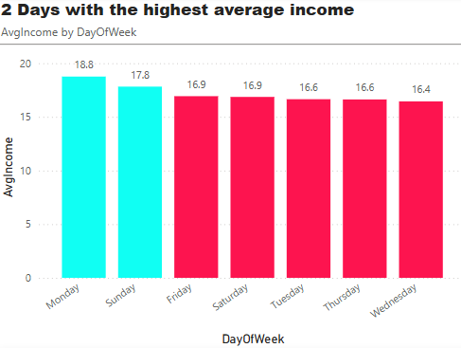
💡What is the day with the highest average income?
Monday :
Possibly related to commuting to work – the beginning of the week brings increased demand.
Sunday :
Could be a peak due to:
Weekend tourism, traveling
Outings (restaurants, events)
Weekend days off or relaxation

Slide 9
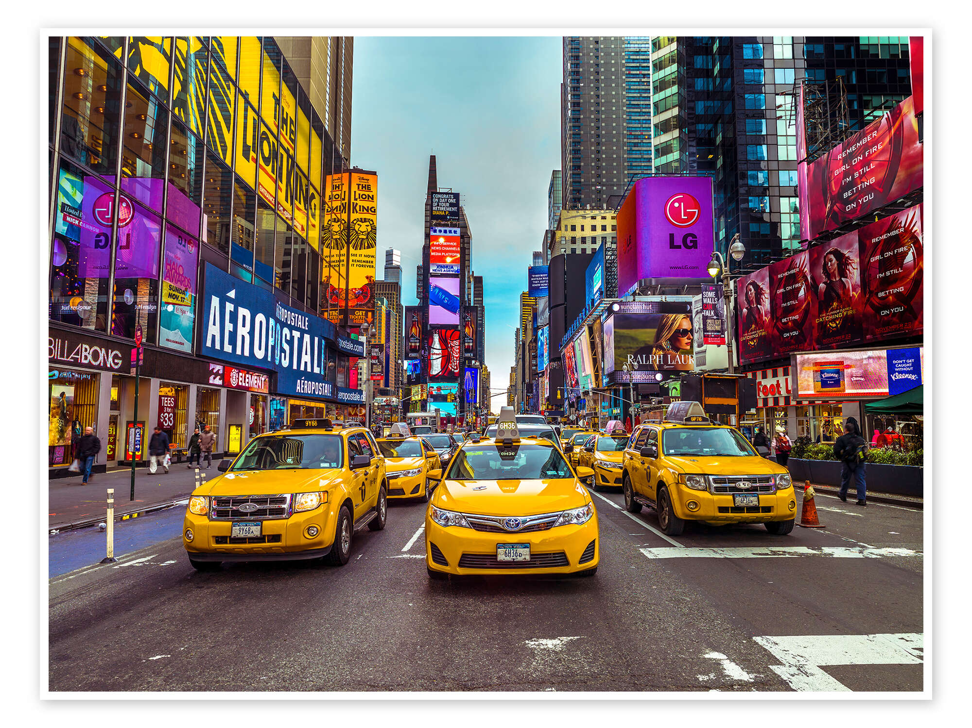
✅ The rest of the weekday shows lower average incomes, suggesting a more stable rhythm, without notable activity peaks.
✅ This distribution provides an interesting insight into how urban mobility behavior has been influenced in the immediate post-pandemic period, with a focus on the beginning and end of the week.

Slide 10
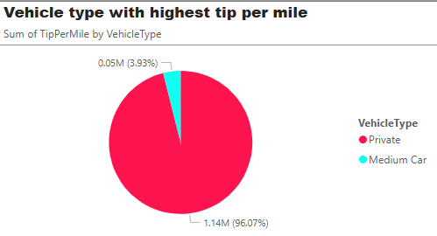
💡 Which vehicles have the highest tip per mile?
🔴 Private Vehicles
Have the overwhelming majority of tips per mile.
This may indicate:
Longer trips or more generous customers
May offer a more personalized / comfortable experience
More trips in total => higher total amount
🔵 Medium Car
Although they may seem more efficient, they collected very little in tips relative to distance.
Possible causes:
Shorter trips
Different clientele (maybe ridesharing)
Fewer vehicles of this type

Slide 11
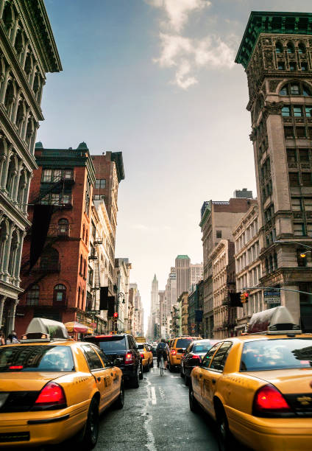
🎯 Conclusion:
✅ "Private" vehicles clearly dominate in terms of tips per mile during May–June 2020 in New York.
✅ The graph suggests a passenger preference for this type of car – either for comfort or frequency

Slide 12
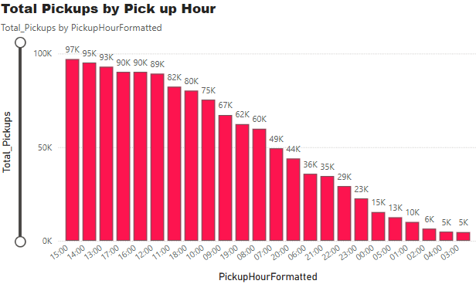
💡 What are the total ride pickups per hour?
Key observations:
🔝 Peak hours:
3:00 PM – 97K rides 👉 the busiest hour!
These hours are typically associated with:
Leaving work/school
Tourism/afternoon activities
Personal or business transportation

Slide 13
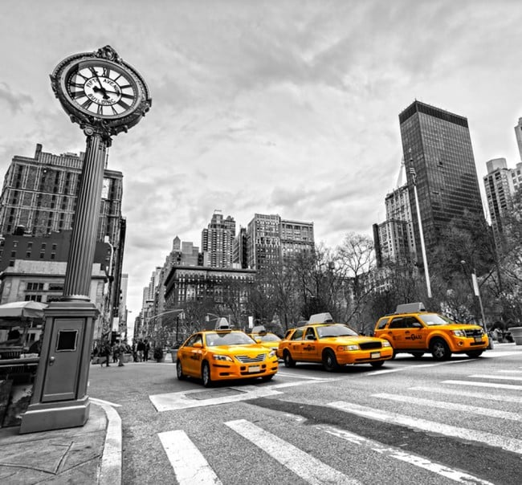
🧠 General interpretation:
High activity evident between 12:00 and 18:00 (lunch–evening).
After 19:00, activity begins to gradually decrease.
The lowest traffic is between 02:00–05:00 AM, when demand is minimal.
🎯 Conclusion:
✅ Taxi activity in NYC, May–June 2020, reaches a clear peak in the second part of the day, especially between 1:00 PM–5:00 PM.
✅ Nighttime is significantly quieter, with the lowest number of trips after 2:00 AM.

Slide 14
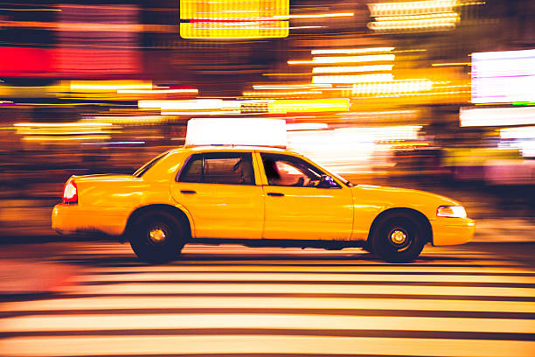

Thank you for your time and attention !

